Slide 1
Task Board Setup
Introduction to Flyingdonut

Slide 2
References
https://www.flyingdonut.io/app/usage.tutorial
https://www.youtube.com/watch?v=Rxy82vAwSrY

Slide 3
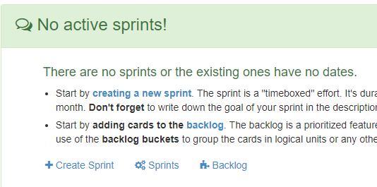
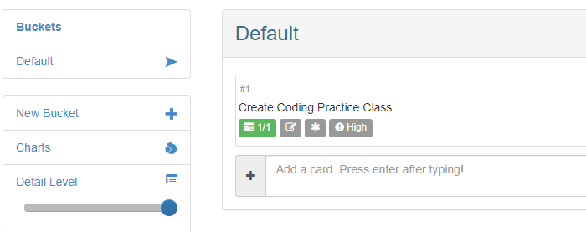
1. Backlog
Create buckets
GUI
I/O
Other
Issues

Slide 4
1. Backlog
Add cards (user stories) to each bucket, for each card:
Add estimate
Add importance
Add description
Add acceptance criteria
Estimated Hours
Importance

Slide 5
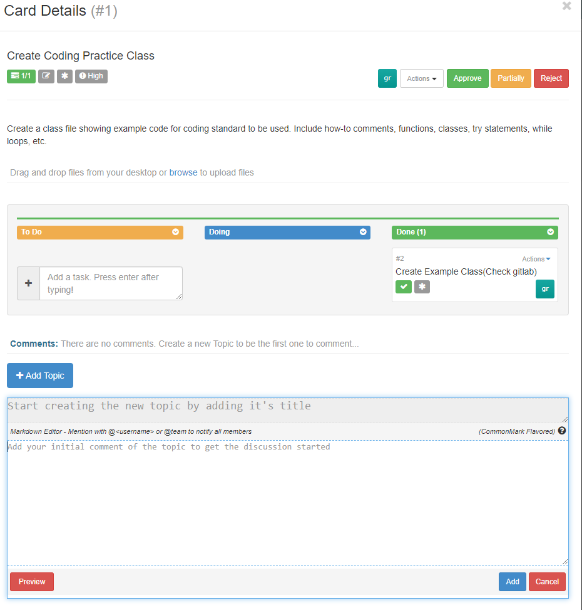
Description
Acceptance Criteria

Slide 6
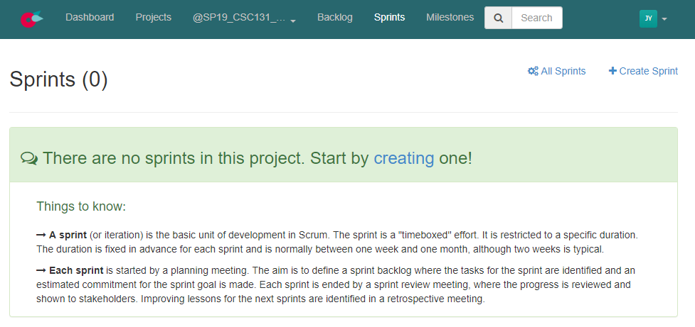
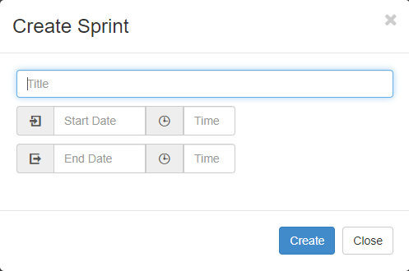
2. Sprint 1
Create Sprint 1 – GUI
Start date: Today
End date: Next Wed (April 24)

Slide 7
2. Sprint 1
Add some GUI-related cards into Sprint 1
Add as many as you can complete within this Sprint
For each card,
Break it down to one or more tasks. And for each task,
Specify the title: what shall be implemented
Add acceptance criteria as the description of the task
Make an estimate of working hours needed
Assign a task to a team member

